Slide 1

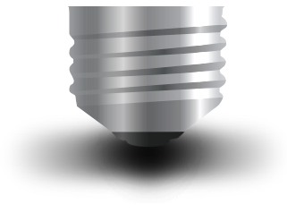
Embedded Systems Security
Brought to you by Whitescope
contact@whitescope.io
Version: 0.1B

Slide 2
Thanks
Content Development/Review:
Terry McCorkle
Jonathan Butts
Admin/Logistics:
Charles Warloe (licensing discussion)
Jose Granado, my first infosec mentor, RIP

Slide 3
Thanks
To the members of information security community, who provided me with the opportunity and support to learn about cybersecurity. I can never fully pay back everything that was given to me, but I hope you will accept this as a token of my gratitude for every thing you’ve helped me with.
Thank you!

Slide 4
About:This Course
This course is intended to be a foundational course for embedded device security. The labs are designed to provide a repeatable, low cost approach to learning embedded device security fundamentals.
This material will be periodically updated and is maintained here:
https://github.com/bkrios/Embedded-Device-Security-Training/

Slide 5

About:Whitescope
Embedded device security consulting
Software solutions for Building Control security
Hands on experience with:
Aviation security
DoD weapon systems
Automobile cyber security
Locomotive cyber security
Sporting stadiums / event cyber security
Building Automation/Control

Slide 6











About:Author
Billy Kim Rios
Founder

Slide 7
Understanding the License
This course is licensed under as:
Creative Commons – Attribution + Noncommercial (BY-NC)
If you’d like to teach this course WITHOUT charging a fee, please grab the slides and instructor materials from the Github.
If you’re going to charge students/customers for activities utilizing these materials, you’ll need to purchase a license. Contact us at:
training@whitescope.io

Slide 8
Agenda
TDB

Slide 9
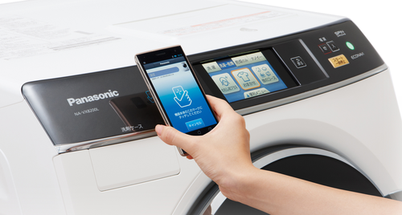
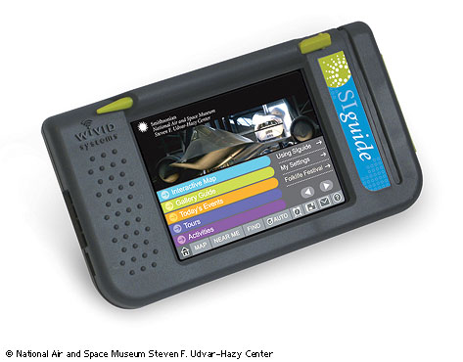
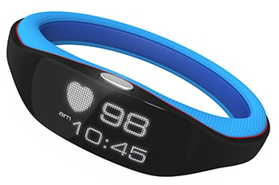
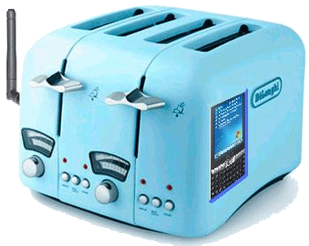
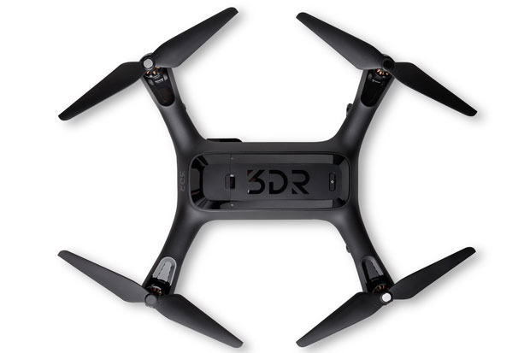
Examples of Embedded Systems

Slide 10
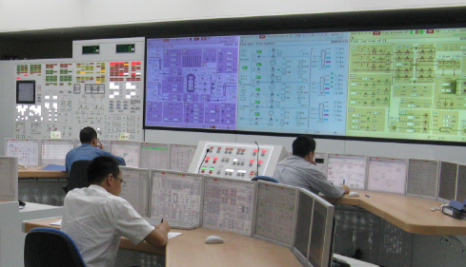
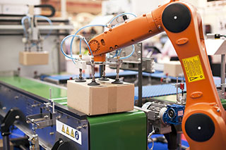

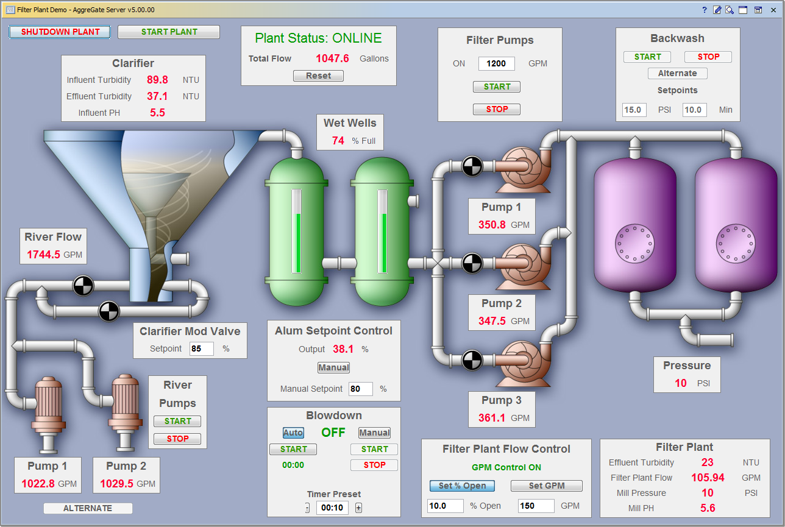
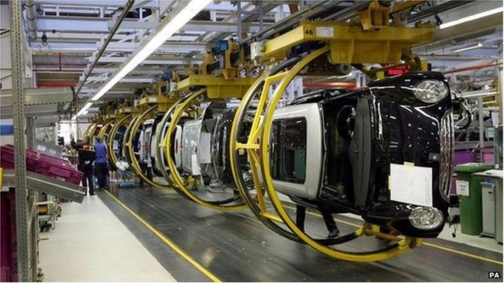
These are Embedded Systems Too

Slide 11

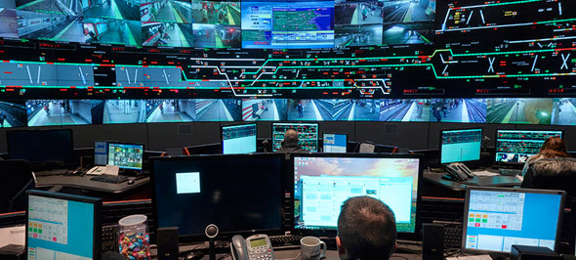


These are Embedded Systems Too

Slide 12
Traditional IT Systems
Confidentiality
Integrity__
Availability
Focused on data
Protecting business
Protecting brand

Slide 13
Embedded Systems
Safety
Patient Harm
Fire Hazard
Over Pressure
Targeting Miss
Unauthorized Launch
Unauthorized Jettison
Misdiagnosis
Striking Hazard
Proportionality Miss
Explosion Hazard
Manufacturing Defect

Slide 14
Embedded Device Security Challenges
Fragmentation makes scaling defense difficult
Customized/proprietary hardware needed for analysis
Constraints on hardware make “extras” hard to implement
Instrumentation can be difficult, especially for automation
Attackers may have physical access to the device
Training hasn’t matured like other cybersecurity areas
Regulatory requirements can introduce additional complexity

Slide 15
Embedded Systems – Owner
Has ownership of the system
Can establish contractual obligations for manufacturers
Should work closely with operators to understand requirements
Should work closely with manufacturers and integrators
Can be different from the operator of the system (ex. comm air)
May be liable for actions arising from the system

Slide 16
Embedded Systems – Operator
Operates the system
Typically has the most interaction with the system
Usually has the deepest understanding of system capabilities
May not understand the technical details associated with components
Can also be the owner, but not usually the case with complex systems
May have liability for effects resulting from system activities

Slide 17
Embedded Systems – Manufacturer
Builds the components within a system
Components may be custom built or off the shelf
Usually responsible for updating software/firmware on components
Should have the deepest understanding of tech details of systems
May also act as a system integrator or a maintainer

Slide 18
Embedded Systems - Integrators
System integrators typically provide subject matter expertise
Assist in the implementation/deployment of complex systems
Have a hand in developing deployment architectures
Can assist/direct the selection of technologies and components
May also act as a maintainer or even as an owner/operator

Slide 19
Embedded Systems - Maintainers
Provide support activities to keep the system running
Typically has privileged access to the various system components
Normally has the ability to query components and collect data
Access to maintenance tools and software
Typically has deep, technical knowledge of system components
Can also be a system integrator

Slide 20
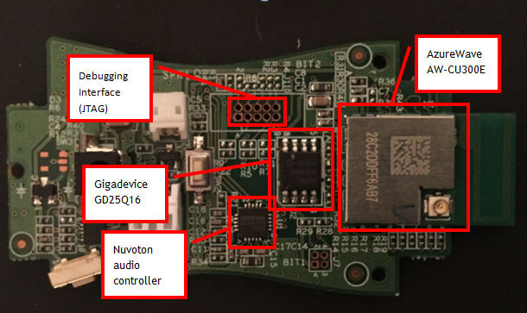
Embedded Systems - Components

Slide 21
Microprocessors
Processing unit, typically on a standalone integrated circuit
Typically does not have built in RAM/ROM/peripherals
Typically does not have other peripherals built in
May be more suitable for general purpose computing

Slide 22
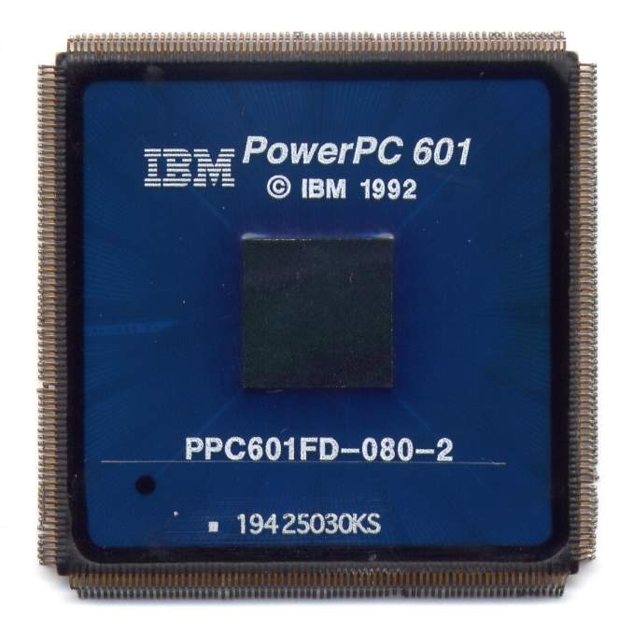
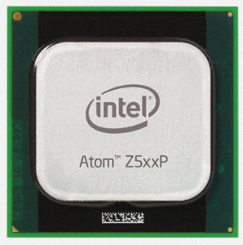
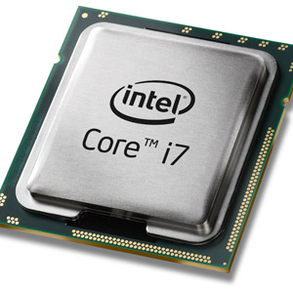
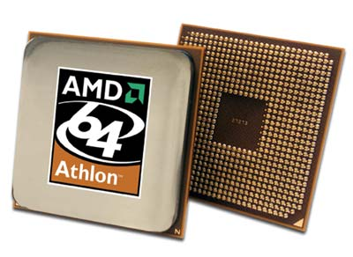
Microprocessors

Slide 23
Microcontrollers or System on Chip (SOC)
Can contain a microprocessor
Typically contains the peripherals required to run applications
May be more appropriate for special purpose systems
Can include peripherals like:
Graphics Processing Unit
Global Positioning System
USB support
WiFi or cellular support

Slide 24
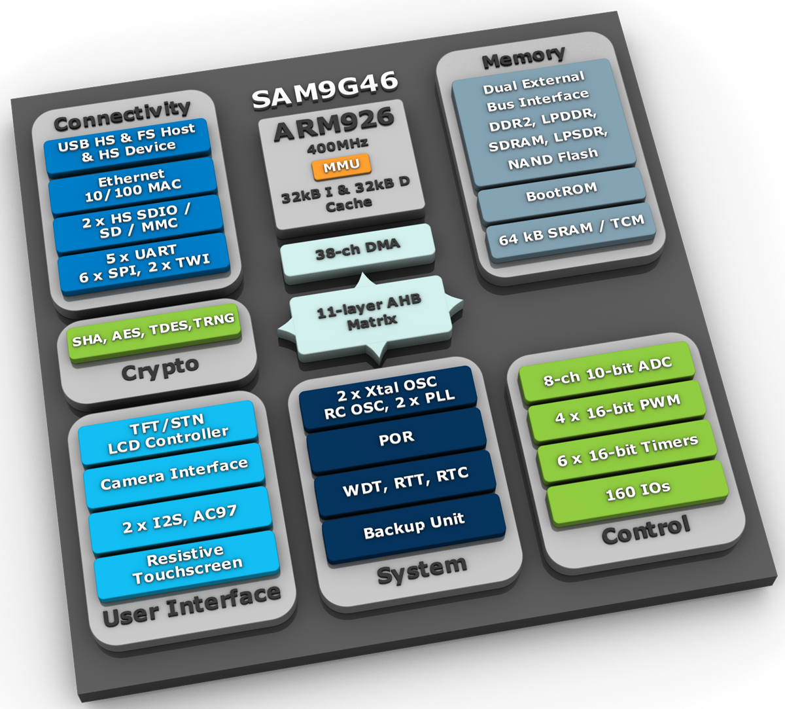
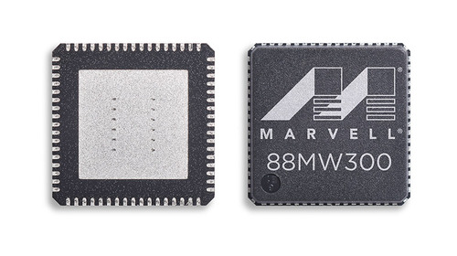
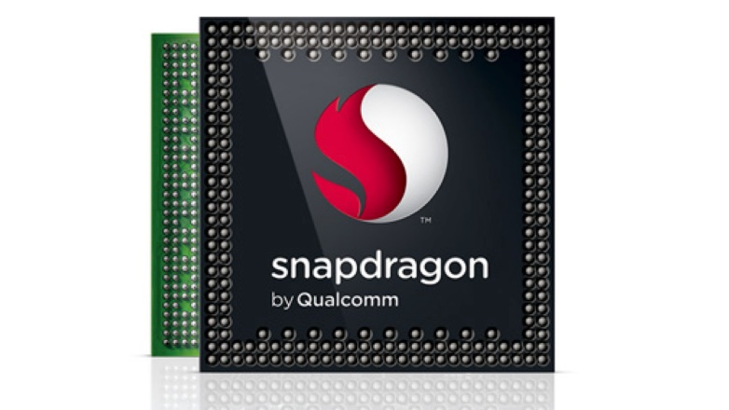
Microcontrollers or System on Chip (SOC)

Slide 25
x86
Originally named after the instruction set used on 8086 processors
Now refers to 32bit instruction set compatible with Intel’s 386
x86 utilizes a variable instruction length
Based on Complex Instruction Set Computing (CISC)
Very common in general computing devices
Less common in embedded systems, but they do exist

Slide 26
ARM
Advanced RISC Machine
Based on Reduced Instruction Set Computing (RISC)
ARM Holdings (SoftBank Group) develops and licenses ARM
Various companies license ARM and produce their own products
Supports 32-bit instruction sets (some support 16-bit instructions)
Extremely common in embedded devices

Slide 27
RISC
RISC based architectures utilizes fewer transistors than CISC
Fewer transistors translates into lower costs and power requirements
Utilizes a (relatively) small, highly optimized set of instructions
Processor cycles required to execute a single instruction is “reduced”
Utilizes a load and store architecture
Logic and arithmetic instructions operate only on CPU registers

Slide 28
PowerPC (PPC)
Created in 1991 by the Apple, IBM, Motorola alliance (AIM)
Utilizes a RISC instruction set architecture
Based on the POWER instruction set (POWER ISA in newer chips)
32-bit and 64-bit implementations
Can switch endianness through the Machine State Register
Used in automobiles and avionics

Slide 29
MIPS
Created in 1981 at Stanford University
Utilizes a RISC instruction set architecture
Based on the MIPS instruction set
Load and Store architecture
32-bit and 64-bit variants are available

Slide 30
Field-Programmable Gate Array (FPGA)
First FPGA was created in 1985 by Ross Freeman
Integrated circuit containing programmable logic block
Designed to be configured after production manufacturing
Some FPGAs contain built-in memory components
Configuration must be reloaded when power is applied/re-applied
Advantages: Speed, reliability and flexibility
Disadvantages: Lack of support and high complexity

Slide 31
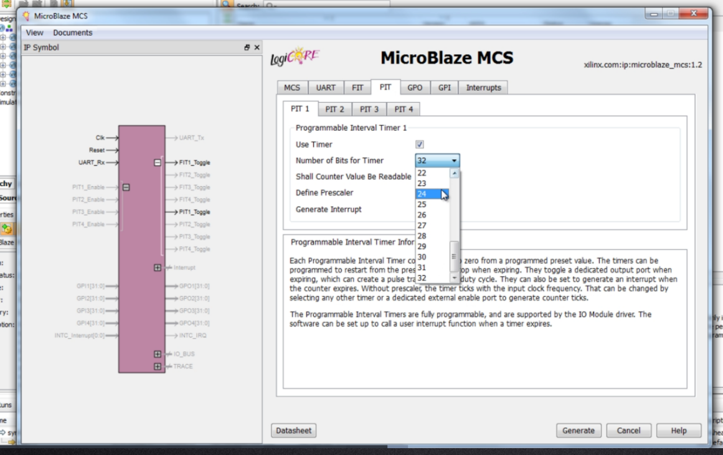
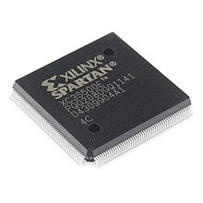
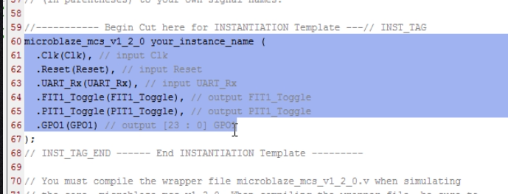
Field-Programmable Gate Array (FPGA)

Slide 32
Complex Programmable Logic Device (CPLD)
EEPROM based
Offers persistence through design locking
Smaller gate count and logic block size when compared with FGPAs
Often used for “simple” logic
Can be faster and more predictable than FPGAs
Usually cheaper than FPGAs, however not as capable

Slide 33
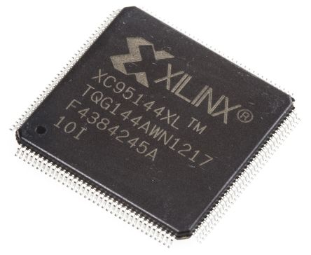
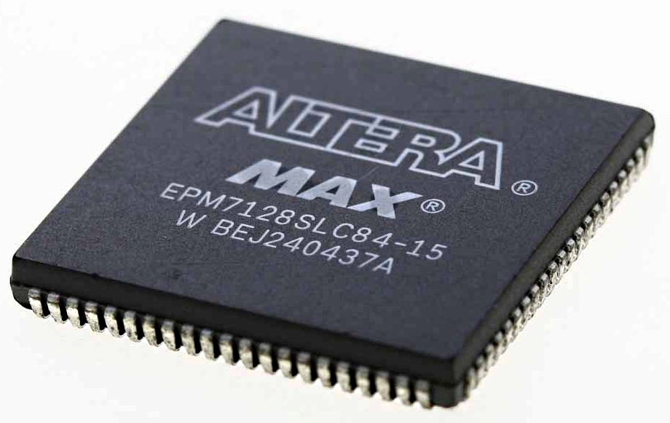
Complex Programmable Logic Device (CPLD)

Slide 34
Chip Packaging

Slide 35
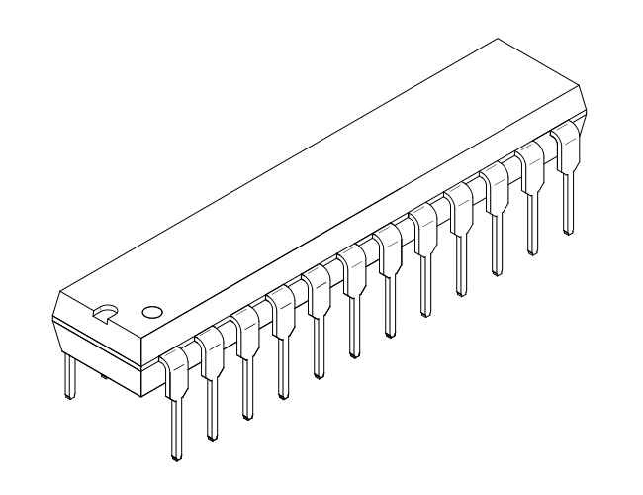
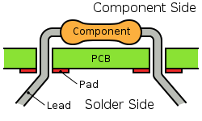
Through-hole Package
Pins for the chips go through the board
Chips are soldered to the underside of the board
Chips are easily removed and replaced
Common in both older and newer chips
External devices can be affixed to the chip

Slide 36
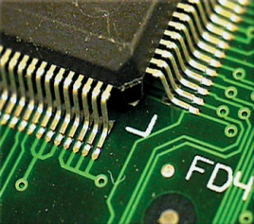
Surface Mount
Chips are affixed to the surface of the board
Each IC leg is soldered to an individual pad
Chips can be removed with little trouble
Chips can be replaced onto original pads
Chips can have affixed, external devices directly to the chip

Slide 37
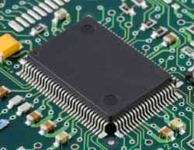
Quad Flat Package
Considered surface mount package
Usually a square chip
Contains pins on each of the four sides
Pin spacing can make soldering more difficult
Multiple variants of QFP (ex. BQFP, TQFP)

Slide 38
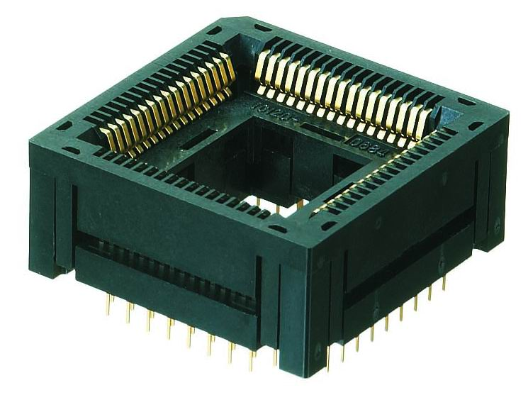
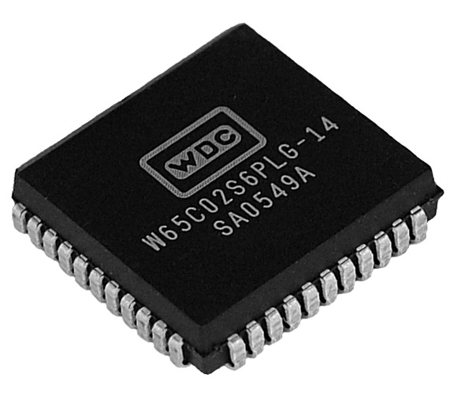
Chip Carrier
Considered surface mount package
Designed to allow for quick removal
Chips are easily replaced
Chips are extracted via chip extractor
Attaching an external device is trivial
Common for ROM as swapping requires low effort

Slide 39
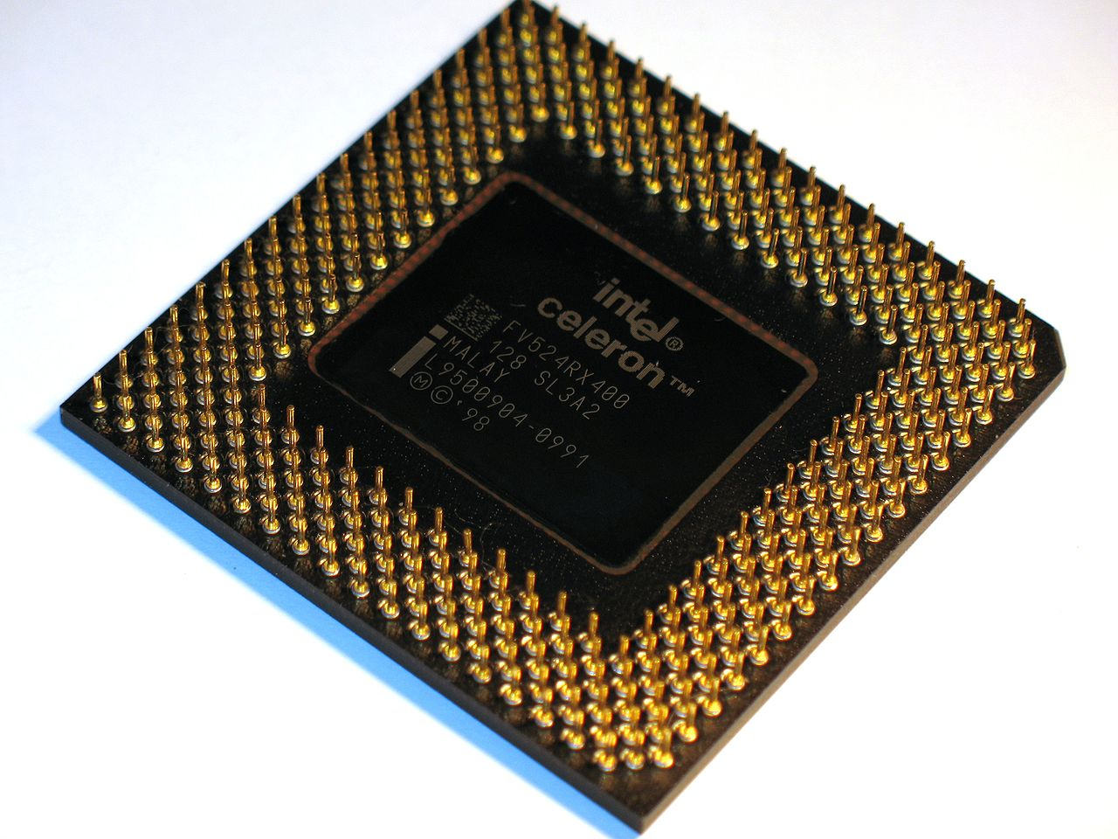
Pin Grid Array
Common amongst processors
Utilizes a “grid” of pins on the underside
In many cases, the chip is removable
In many cases, the chip can be replaced
External devices can be affixed

Slide 40
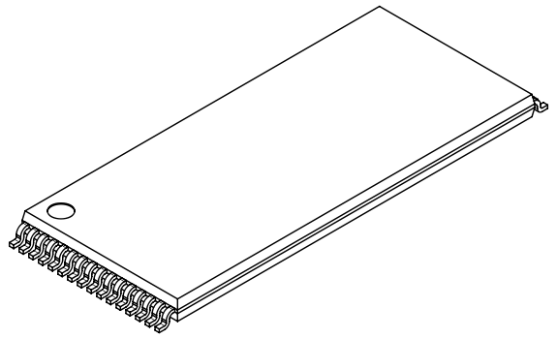
Thin Small Outline Package
Commonly referred to as TSOP
Considered a surface mount package
Frequently used for RAM or Flash
## in TSOP## indicates number of pins

Slide 41
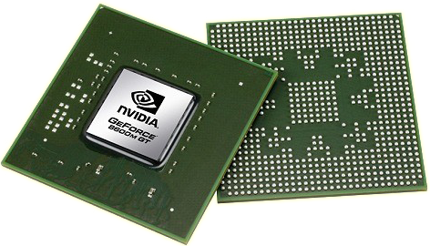
Ball Grid Array
Considered surface mount package
Connections to pads via conductive balls
Connections obscured
Specialized equipment for removal
Common in newer microprocessors/microcontrollers
Pins over the entire surface area = more pins

Slide 42
Random Access Memory (RAM)
Sometimes referred to as volatile memory
Utilized when power is applied to the chip
Contents are typically not available on powered off chips
Software and data stored on RAM
Sensitive data is can stored within RAM (passwords, keys)

Slide 43
Read Only Memory (ROM)
Typically offers a persistent means to store applications/data
Applications/data on ROM should survive a power cycle
Contents burned to chip at manufacture time
Some chips offer a capability to erase and re-program
Typically stores a firmware image that is loaded to RAM
Can store the bootloader

Slide 44
Communication Buses
Provides the paths for various components to communicate
Ex. Processor utilizing data from RAM
If the bus is exposed, it can be tapped
Buses can reside between PCB layers making it more difficult to tap

Slide 45
Embedded Systems Architectures

Slide 46
Embedded Systems - Hardware
Goals

Slide 47
Embedded Systems - Software
Goals

Slide 48
Embedded Systems - Firmware
Firmware is actually software
Contains the logic to operate the embedded devices
Typically contains the logic to initiate physical effects
Usually loaded on non-volatile memory (ROM, EPROM, flash)
Some firmware is permanent and cannot be updated
Most newer devices provide a path update firmware

Slide 49
Bootloaders
Software that loads follow-on software on the embedded system
Usually small in size
Typically loads and initializes the operating system on the device
Can provide a mechanism for recovery if an OS failure occurs
Some systems do not utilize a bootloaders
Some systems boot directly into an application program

Slide 50
Bootloaders
Bootloader
Firmware 1
(typically compressed)
Firmware 2
(typically compressed)
Flash EEPROM

Slide 51
Bootloaders
Flash EEPROM
Bootloader
Firmware 1
Firmware 2
Reset Vector
DRAM

Slide 52
Bootloaders
Flash EEPROM
Bootloader
Firmware 1
Firmware 2
Initialize DRAM
DRAM

Slide 53
Bootloaders
Flash EEPROM
Bootloader
Firmware 1
Firmware 2
Execute Firmware1
DRAM

Slide 54
Bootloaders
Flash EEPROM
Bootloader
Firmware 1
Firmware 2
Decompression
DRAM
Real Time OS

Slide 55
Bootloaders
Flash EEPROM
Bootloader
Firmware 1
Firmware 2
Switch from Flash execution to DRAM
DRAM
Real Time OS

Slide 56
Bootloaders
Flash EEPROM
Bootloader
Firmware 1
Firmware 2
DRAM
Real Time OS
Temp Storage
DRAM Execution

Slide 57
Firmware Update
Bootloader
Firmware 1
(typically compressed)
Firmware 2
(typically compressed)
Flash EEPROM

Slide 58
Real Time Operating Systems
Many embedded devices utilize Real Time Operating Systems (RTOS)
RTOS can look/feel like traditional operating systems
RTOS do implement more controlled/defined scheduling
Many include watchdog components to increase reliability
Some RTOS are “certified” (ex. Greenhills Integrity)
Applications usually run with high privileges

Slide 59
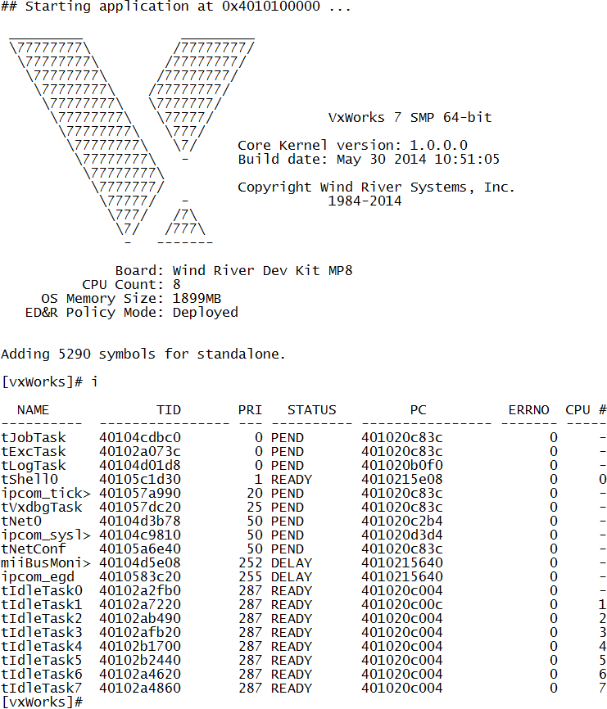
VxWorks
Common RTOS found in a variety of systems
Developed by Wind River in 1987
Supports MIPS, x86, PPC, and ARM
User-mode apps serperated
Used in the Mars Rover and other devices

Slide 60
BusyBox
A RTOS built specifically for embedded devices in 1999
“The swiss army knife of Embedded Linux”
Very popular amongst embedded devices
A single executable that provides a number of stripped down tools
Single binary reduces overhead
Single binary allows code to be shared between multiple apps
Released as free software under GNU General Public

Slide 61
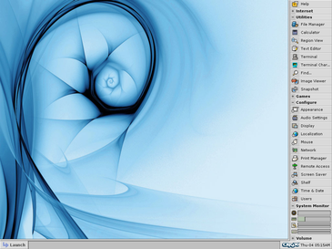
QNX
RTOS originally developed in 1982 by Quantum Software Systems
One of the first commercially successful microkernel OS
Supports MIPS, PPC, x86, and ARM
Unix like OS with GUI and shell
Older systems can be deployed on a FD
Used in automotive telematic systems

Slide 62
Android
Bought by Google in 2005 and released in 2007
Based on the Linux Kernel
Auto version for automotive, Wear version for wearables
Runs a variety of mobile devices, tablets, and notebooks
Primary interface based on gestures (touch, swipe…etc.)
Apps written in Java with unmanaged (C/C++) libraries

Slide 63
IOS
Mobile Operating System created by Apple in 2007
Primary interface based on gestures (touch, swipe…etc.)
Native applications written in Swift, Objective-C, C, C++
Applications are served via the Apple App Store
Based on the XNU operating system (X is not Unix)
Hybrid kernel based on the Mach Kernel and BSD

Slide 64
Integrity
Developed by Greenhills and released in 2008 (commercial)
First system to be certified by NIAP to EAL-6
POSIX based RTOS
User/Kernel separation
Supports 32-bit and 64-bit platforms
Support for ARM, MIPS, PPC, x86
Utilizes the MULTI IDE

Slide 65
Embedded Linux
Based on the Linux Kernel and used on embedded devices
Supports ARM, MIPS, PPC and x86
No royalties or licensing fees (unless through third parties)
Redistributable source code available
Comparatively larger footprint compared to other RTOS
Familiar OS core and toolchains

Slide 66
Windows
Graphical operating system made by Microsoft
Introduced in 1985
32bit and 64bit support
Support for x86 and now ARM
Client/Server operating system variants
Various OS SKUs for different purposes

Slide 67
Windows CE
Windows Embedded Compact Edition
Actually a RTOS as interrupt latency is deterministic
Supports x86 and ARM processors (MIPS prior to version 7)
Optimized version of Windows to run on minimal memory (1MB)
Can be configured to run without volatile storage (ROM)
Larges parts of the Windows CE source is available to OEMs

Slide 68
Windows IoT
Previously known as Windows Embedded
Includes: Windows NT, XP, 2009, 7 and 8 Embedded
Installation footprint from 40MB (XPE) to 300MB (Win 7 Embedded)
Many embedded SKUs include standard Windows features
Ex. RDP, .NET, Internet Explorer, Media Player may be accessible
IoT Core – Provided for free for hobbyist use

Slide 69
Windows RT
Mobile Operating System based on the Windows 8 core
Support 32bit ARM processor architecture
Unveiled in 2011 at the Consumer Electronics show
Utilized in Windows tablets
Can only execute software signed by Microsoft

Slide 70
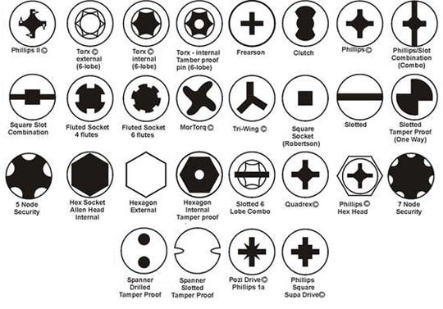
Tools
Traditional tools are useful in HW reviews
In some cases, specialized tools are needed
Security bits for screws are not unusual
Debugging tools for embedded systems
Hardware tools for chip extraction

Slide 71
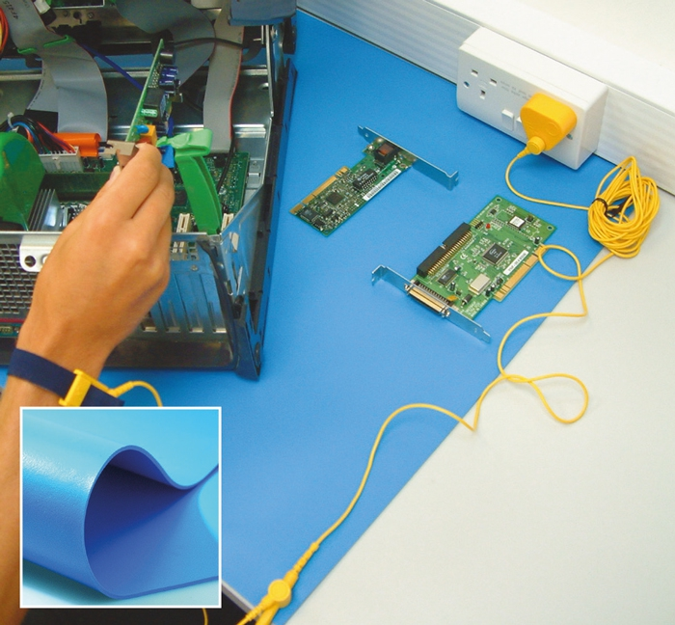
Electrostatic Discharge
Static electricity can fry chips
ESD straps can help minimize ESD
ESD pads for electronic workspaces
ESD equipment not a safety device
Safety procedures must be followed

Slide 72
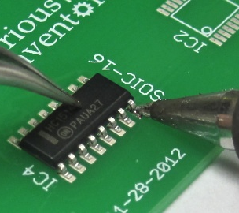
Soldering
Process of joining two metal items
Forms a permanent connection (kinda)
Solder melts to join metal (not metals)
Solder is conductive
Breadboard can be used for testing

Slide 73
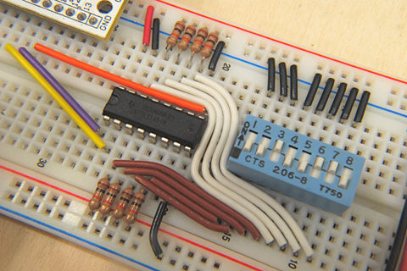
Breadboards
Sometimes referred to as prototype board
AKA solderless breadboard
Does not require solder
Reusable across multiple projects
Used for rapid prototyping

Slide 74
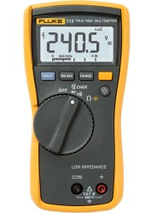
Multimeters
Sometimes referred to as an multi-tester
AKA Volt Ohm Meter
Analog and Digital versions
Usually handheld
Variety of measurements: Current, Volts, amps, ohms

Slide 75
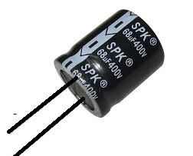
Capacitors
Used to store electrical energy, acting as a temporary battery
Can be used to block DC while allowing AC to pass
Can be used to filter/stabilize output of power
In some cases used for signal processing
Utilizes color bands for tolerance
Capacitors can have safety risks, handle with care

Slide 76
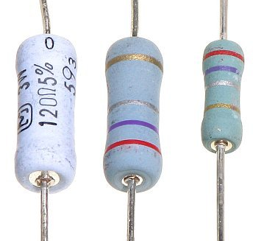
Resistors
Used to reduce current
Behavior is defined by Ohm’s law
V = I * R
Can be used in series or parallel
Must be properly rated
Utilizes color codes for rating

Slide 77
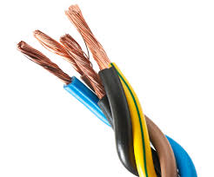
Wires
Used to transmit electricity from a component to another
Must be rated for use (environment, current..etc.)
Size measured in gauge (AWG)
Smaller gauge is a larger wire
Copper, Aluminum, and other metals

Slide 78
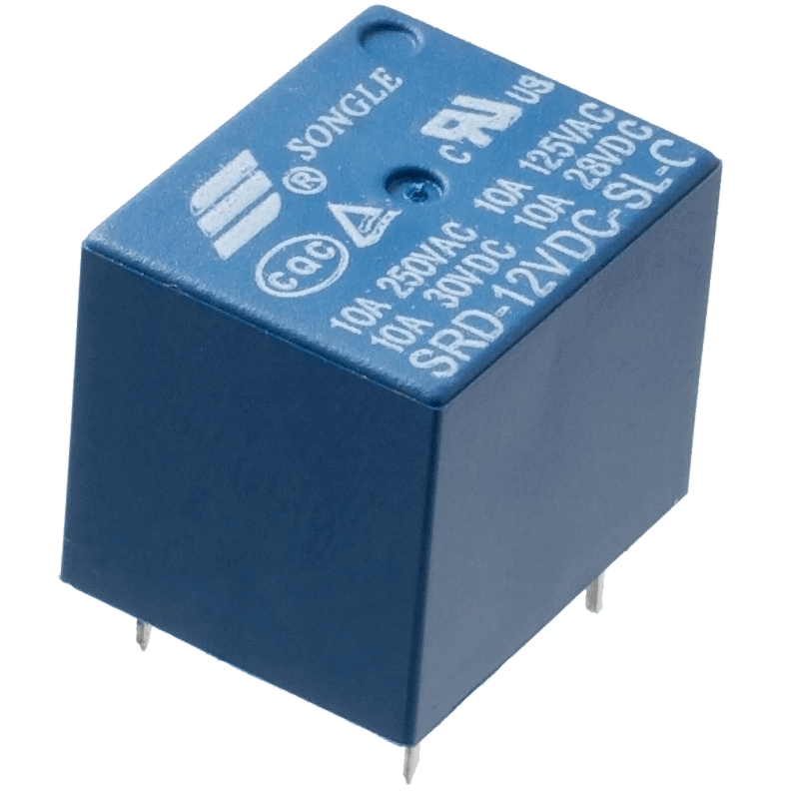
Relays
Electrically operated switch
Can be triggered by applying voltage
Solid state relays
Latching relays
Protective relays

Slide 79
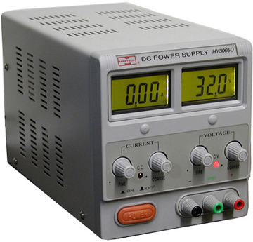
Variable Power Supplies
Different power requirements for systems
Some require specialized power adapters
VPS provide the correct current/voltage
Usually connects directly to the PCB
DC is commonly used

Slide 80
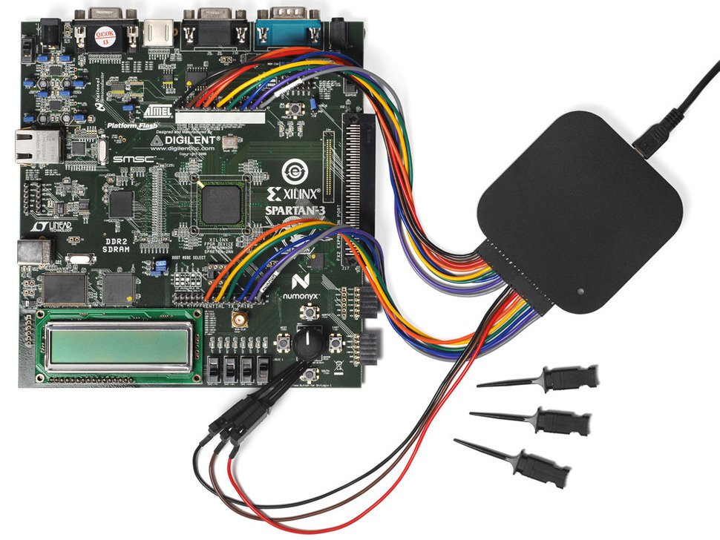
Logic Analyzers
Captures digital signals
Attaches to comm bus
Captures signals and records
Decodes common protocols
Can help identify protocols in use

Slide 81
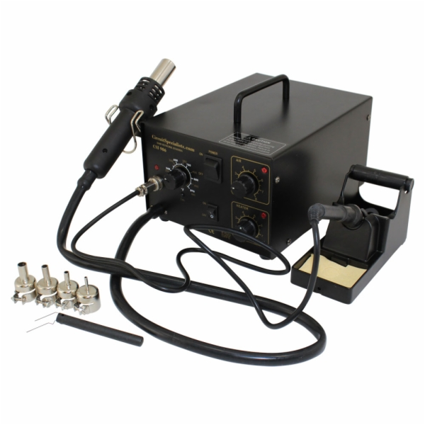
Rework Stations
Utilize hot air to melt solder points
Air is directed via various nozzles
Temperature can be adjusted
Some include vacuum pumps for cleanup
Many rework stations have soldering iron

Slide 82
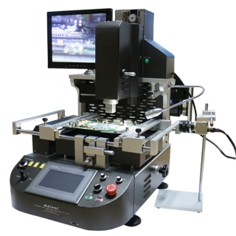
Rework Stations
Rework stations can be very sophisticated
Example: BGA Rework stations
Some rework stations require training
High end rework stations can be expensive
Rework stations can be used to replace chips

Slide 83
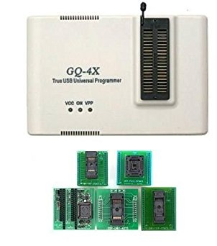
EPROM Programmer
Used to extract firmware directly from chips
Applied correct voltage to correct pins
Adapters can be used for various packages
Can also hook directly to legs
Can be adapted for new chipset
Datasheets are used to create new profiles

Slide 84
On-chip Debuggers
A mechanism to examine program execution on the target chip
Allows for pausing of program execution (breakpoint)
Allows for the alteration of program values
Increased need for OCD as processors gain speed and complexity

Slide 85
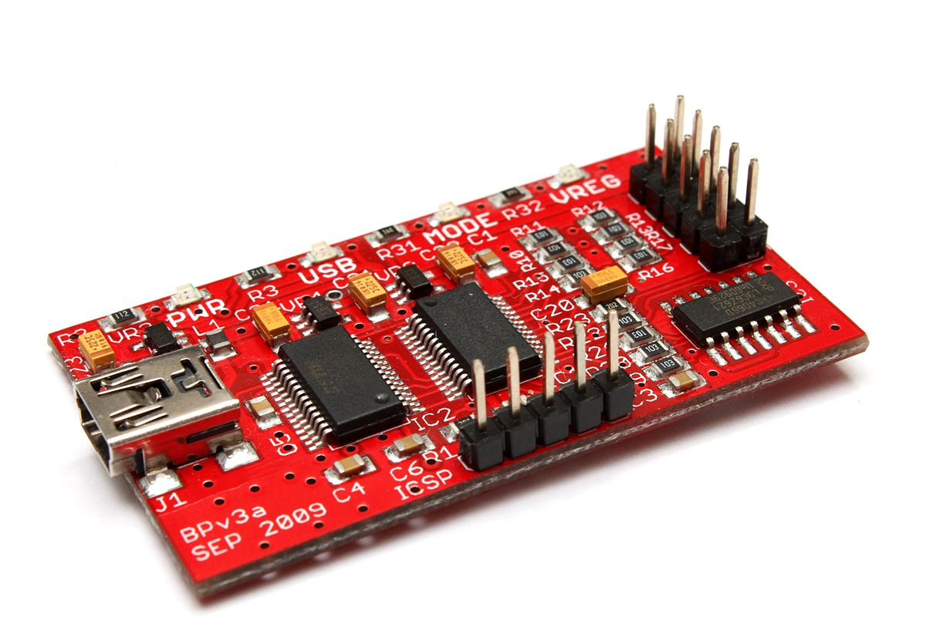
Bus Pirate
Open source tool that can communicate to hardware interfaces
Allows for JTAG interaction
Allows for FPGA/CPLD programming
Compatible with OpenOCD
Can be slow
May not work with newer chipsets

Slide 86

J-Link
Made by Segger
One of the most well known debug probes
Supports ARM 7/9/11 and Cortex
Supports Renesas RX
Supports GDB based debugging
Various versions provide different speeds

Slide 87

Atmel ICE
Debugging tool for Atmel microcontrollers
Supports ARM Cortex-M
Supports Atmel AVR
Provides on-chip debug
JTAG, SWD, TPI
Kit comes with adapters

Slide 88

Atmel SAM ICE
Debugging tool for Atmel microcontrollers
Supports Atmel SAM microcontrollers
Supports Thumb mode
Provides on-chip debug
JTAG, SWD, SWV
GDB server support

Slide 89

XILINX
XILINX provides the Vivado IDE for FPGA programming
Supports XILINX hardware debugging devices
eFUSE AES Key/registers
On-chip debug

Slide 90

Interfacing with Embedded Systems

Slide 91

Identification

Slide 92
Datasheets
Datasheet provide tremendous amounts of information about chips
Detailed information on capabilities of microprocessors/controllers
Description of processor architecture
Identification of pinouts and protocols
Identification of support for debugging interfaces
Can greatly aid reverse engineering efforts

Slide 93

Datasheets

Slide 94

Datasheets

Slide 95
Pinouts
Pinout documentation describes the purpose of each pin for a chip
Microprocessors/microcontrollers have over a hundred different pins
Having a reference describing what pins do what is vital to debugging
The sheer number of pins usually make brute force difficult
Utilizing a reference that describes the purpose of each pin is useful
Datasheets usually contain pinout information

Slide 96

Pinouts

Slide 97

Pinouts

Slide 98

Pinouts

Slide 99
Tracing
Tracing

Slide 100

JTAGULATOR
Automatic, assisted discovery of on-chip debugging interfaces
Useful when datasheets are not available
Useful when tracing from the processor is not available
Useful when processor pins cannot be reached (ex. BGA)

Slide 101
Communications Interfaces
Main boards communicate with various components
Systems utilizes various communications interfaces and protocols
Identifying communications interfaces is vital to reverse engineering
Some communications interfaces are custom, but many are standard

Slide 102
RS-232
RS-232 is very common amongst embedded devices
RS-232 defines the characteristics (voltage, signaling…etc.)
RS-232 also defines interfaces and pin identification
Some vendors have custom interfaces that do not adhere to standard
RS-232 defines the signaling, it does not define the data protocols
Slow, compared to modern standards

Slide 103
RS-232
Data Carrier Detect
Receive Data
Transmit Data
Data Terminal Ready
Signal Ground
Data Set Ready
Request to Send
Clear to Send
Ring Indicator

Slide 104



RS-232

Slide 105
RS-485
RS-485 is very common amongst embedded devices
RS-485 defines the characteristics (voltage, signaling…etc.)
RS-485 also defines interfaces and pin identification
Some vendors have custom interfaces that do not adhere to standard
RS-485 defines the signaling, it does not define the data protocols
Slow, compared to modern standards

Slide 106
RS-485
D+
Ground
D-

Slide 107



RS-485

Slide 108
Transistor-transistor logic
Commonly referred to as TTL
Allows for serial communication
Communication is accomplished by alt between high and low voltage
Common voltages are 5.0V (high) and 3.3V (high) and low
Commonly used for debugging microcontrollers/processors

Slide 109
UART
Universal Asynchronous Receiver/Transmitter
Used for asynchronous communication
Used to transmits and receive data serially
Transmit one bit at a time at a specified baud rate
9600bps is one of the most common baud rates
Other common baud rates: 19200, 38400, 57600, 115200

Slide 110
Serial Peripheral Interface Bus
Commonly referred to as SPI
Synchronous serial communications
Used for short distance communications
Typically employs four wire serial-bus
Utilizes a master clock for synchronization
During each SPI clock cycle, full duplex transmission occurs

Slide 111
Serial Peripheral Interface Bus
SCLK – Serial Clock
MOSI – Master Output Slave Input
MISO – Master Input Slave Output
SDIO – Serial Data I/O
SS – Slave Select

Slide 112
Inter Integrated Circuit
Commonly referred to as I2C
Pronounced “I” “Two” “C”
Short distance, low speed communications bus
Utilizes 3.3V and 5V for signaling
Utilizes a clock for communications
Master node establishes the clock, slave nodes sync

Slide 113
Joint Test Action Group (JTAG)
Electronics industry association formed in 1985
Established standards for on-chip debugging and instrumentation
Uses serial communications at different speeds
Some vendors have extended upon the JTAG standard
Applies to many microprocessors/microcontrollers/FPGAs
Different configurations for low pins, regular, and extended

Slide 114
Joint Test Action Group (JTAG)
TDI – Test Data In
TDO – Test Data Out
TCK – Test Clock
TMS – Test Mode Select
TRST – Test Reset

Slide 115
Joint Test Action Group (JTAG)
Two pin
TMSC – Test Serial Data
TCK – Test Clock

Slide 116
Serial Wire Debug
Alternative to JTAG
Utilizes a 2-pin electrical interface
Utilizes the same protocol as JTAG
Defined in the ARM debug interface v5
On JTAG devices that support SWD:
TMS and TCK are used for SWDIO and SWCLK signals

Slide 117
Reverse Engineering Tools

Slide 118
Disassembler
Converts machine language into assembly language
Can extract function names and strings
Typically provides call graphs to show code execution flow
Add-ons may be required for embedded processors

Slide 119

Disassembler

Slide 120

Disassembler

Slide 121
Hex Editor
Allows for the manipulation of fundamental binary data
“Hex” stands for hexadecimal

Slide 122
Cross Compiler
Lab

Slide 123
Emulators
Lab

Slide 124
Thanks!
“
Billy Rios - Founder
Billy.Rios@Whitescope.io
http://whitescope.io

